Slide 1
Sales Performance and Product Analysis for E-commerce Optimization (sql & Power Bi)
Emmanuel Adewuyi Ojo

Slide 2
Introduction and background
This project analyses the purchases of customers for 1 year for an America E-commerce dataset. To understand customer's online buying habits
The dataset includes information about customer behavior, product details, and transactions. The dataset is available; https://www.kaggle.com/datasets/mervemenekse/ecommerce-dataset
Project Goals: The objective is to analyze the store's sales data to gain insights into its performance. The company wants to identify the top-selling products, highest-grossing months, and trends in different product categories and buying platforms.
The dataset was cleaned in power query before being imported into SQL for this analysis, majorly cleaning involved replacing blanks and null values. The method used to clean involves replacing these records with median value where obvious, and using fill up, function in other place where relevant.

Slide 3
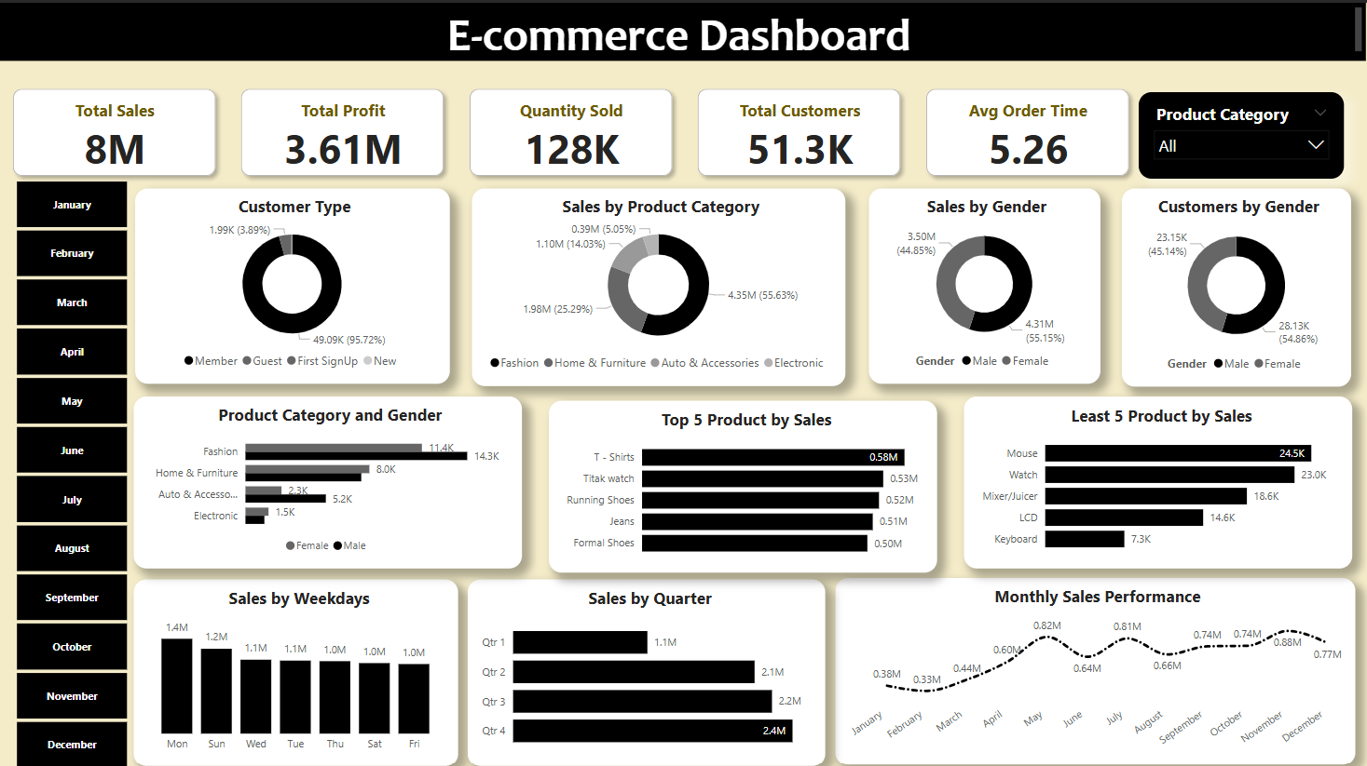

Slide 4
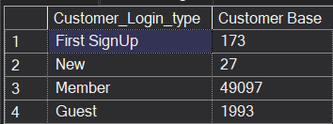
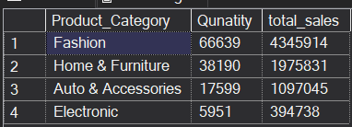
Key insight and findings
Customer Base of the company is made up of 95.72% of Members, 3.89% are guest, and First sign Up and New Member are insignificantly represented. This shows that the business is not making new members and sign up. This suggest a need for more radical marketing drive to attract new customers
In terms of quantity of goods sold by product category, Fashion product category have the highest quantity sold, and this also the case for the total sales by product category.
This suggest that the company should pay more attention in leveraging the high sales in this category.

Slide 5
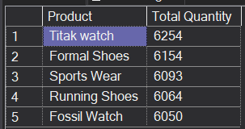
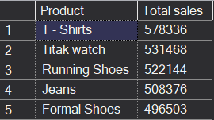
Key insight and findings
Apple Laptop is the most profitable product. With a $67.12 profit per product.
November is the month with the highest sales, with $877,881.
Top 5 best-selling product in terms of quantity include Titak Watch, Formal Shoes, Sport Wear, Running Shoes, and Fossil Watch. However, in terms of Total Sales amount, we have T-shirt, Titak watch, Runing shoes, Jeans, and Formal Shoes Since these product are in high demand, the company should use information to do marketing in other areas were they do not yet have their reach.

Slide 6
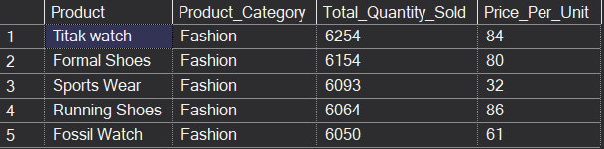
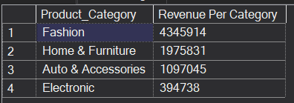
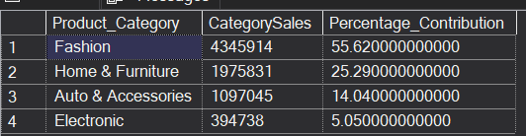
Key insight and findings
The Best Selling Product further Analysis Shows that, the top five best selling product are from the same category (Fashion), the price per unit varies from 32-86 price range with running shoes being the most expensive at 86, and sports wear being the cheapest at 32.
Fashion is the product category with the highest sales, indicating how the category contributes to the business. The company should therefore focus more on these product category, to improve the overall performance of the business.
Detailed characteristics of the five best selling product

Slide 7
Recommendations
With over 95% of customers base being Members, suggest that the business largely serve old customers, which is indicative of inability to attract new customers. It is therefore recommended that the company should invest in effective marketing and advertisement strategies, particularly electronic ads, to attract new customers.
With Fashion product category being the category with most sales, the company need to focus more on these product category, to improve their overall performance of the business. This may include using promotional advertisement to reach broader customer base.
With an average revenue per transaction of $152 and a total revenue of $7,813,528, suggest that the company is generating revenue and profit from the product discounts. This means the company can continue use the discount strategy.
The top five best selling product indicates products that are in high demand, the company should use these information to do marketing in other regions were they do not yet have their reach.

